Slide 1
Traffic avoiding algorithm using improved Dijkstra
Souradeep Nanda (14BCE1037)
KeshaV BhupatHy Vignesh (14BCE1036)
Anand shanker deb (14BCE1175)
Subham agarwal (14BCE1013)

Slide 2
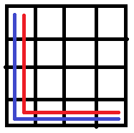
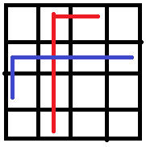
The Problem
Let us say two cars are going from point A to point B of a city. We can calculate the shortest path using Dijkstra’s algorithm.
However, since both have same start and end positions, both will pick the same road. This will increase the traffic at that junction.
Even if they don’t have the same start and end destinations, but happen to get to an intersection at the same time, it will increase congestion.

Slide 3
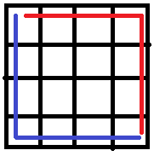
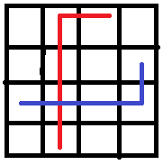
The Solution
If the first car, can “reserve” a path for a particular period of time, then other cars can be notified that the intersection will be busy at that time.
The other cars can avoid that intersection as long as there are better options available.

Slide 4
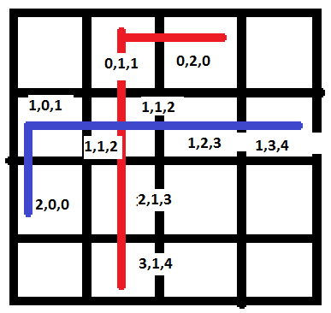
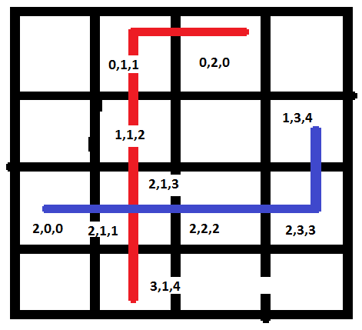
Space Time
The Dijkstra’s algorithm will not only check for weights on the x,y plane but also on the time dimension.
In the first diagram we can see that both cars get to the cell 1,1 at time 2, this will cause congestion if there are many cars.
If we use our improved algorithm, it takes an alternate route and gets to the junction at a different time.

Slide 5
Time Complexity
Time complexity will be same as that of Dijkstra, i.e. O(E log(V))
Where E is number of edges and V is number of vertices.

Slide 6
References
https://en.wikipedia.org/wiki/Dijkstra%27s_algorithm
https://en.wikipedia.org/wiki/Edsger_W._Dijkstra
https://upload.wikimedia.org/wikipedia/commons/8/85/Dijkstra.ogg

